Slide 1

Topic : Neural Networks
Name of Student : Ojus Jaiswal
Roll Number : BACO19108

Slide 2

Today's Agenda
Introduction to Neural Networks
Multi-Layered Perceptron
Types of Neural Networks
Pros and Cons
Applications
Bottom Line

Slide 3
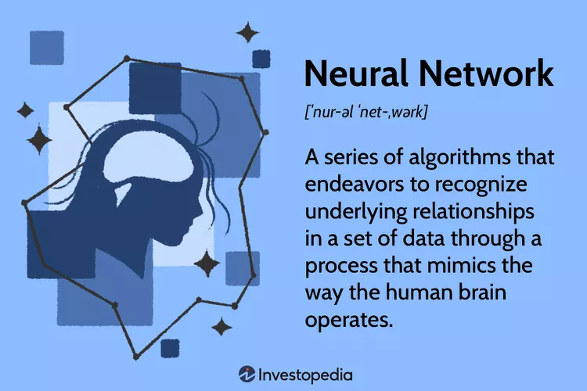
What Is a Neural Network?
A neural network is a series of algorithms that endeavors to recognize underlying relationships in a set of data through a process that mimics the way the human brain operates. In this sense, neural networks refer to systems of neurons, either organic or artificial in nature.
Neural networks can adapt to changing input; so the network generates the best possible result without needing to redesign the output criteria.

Slide 4
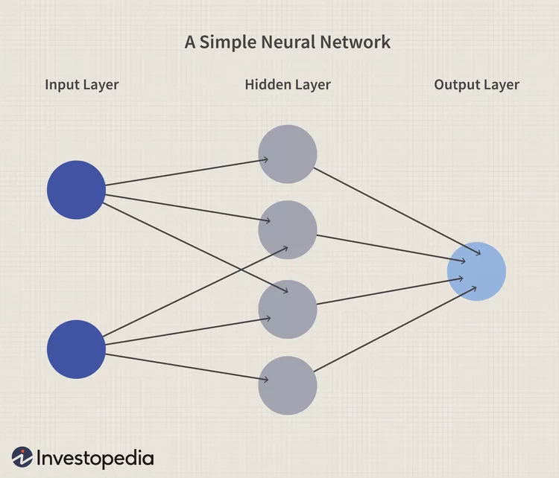
Understanding Neural Networks
Neural networks, in the world of finance, assist in the development of such processes as time-series forecasting, algorithmic trading, securities classification, credit risk modeling, and constructing proprietary indicators and price derivatives.
A neural network works similarly to the human brain’s neural network. A “neuron” in a neural network is a mathematical function that collects and classifies information according to a specific architecture. The network bears a strong resemblance to statistical methods such as curve fitting and regression analysis.
A neural network contains layers of interconnected nodes. Each node is a known as perceptron and is similar to a multiple linear regression. The perceptron feeds the signal produced by a multiple linear regression into an activation function that may be nonlinear.

Slide 5
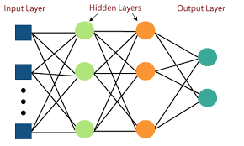
Multi-Layered Perceptron
In a multi-layered perceptron (MLP), perceptrons are arranged in interconnected layers. The input layer collects input patterns. The output layer has classifications or output signals to which input patterns may map. For instance, the patterns may comprise a list of quantities for technical indicators about a security; potential outputs could be “buy,” “hold” or “sell.”
Hidden layers fine-tune the input weightings until the neural network’s margin of error is minimal. It is hypothesized that hidden layers extrapolate salient features in the input data that have predictive power regarding the outputs. This describes feature extraction, which accomplishes a utility similar to statistical techniques such as principal component analysis.

Slide 6
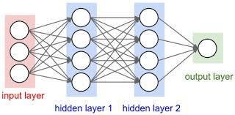
Types of Neural Networks
1. Feed-Forward Neural Networks
Feed-forward neural networks are one of the more simple types of neural networks. It conveys information in one direction through input nodes; this information continues to be processed in this single direction until it reaches the output mode. Feed-forward neural networks may have hidden layers for functionality, and this type of most often used for facial recognition technologies.

Slide 7
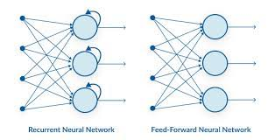
2. Recurrent Neural Networks
A more complex type of neural network, recurrent neural networks take the output of a processing node and transmit the information back into the network. This results in theoretical "learning" and improvement of the network. Each node stores historical processes, and these historical processes are reused in the future during processing.
This becomes especially critical for networks in which the prediction is incorrect; the system will attempt to learn why the correct outcome occurred and adjust accordingly. This type of neural network is often used in text-to-speech applications.

Slide 8
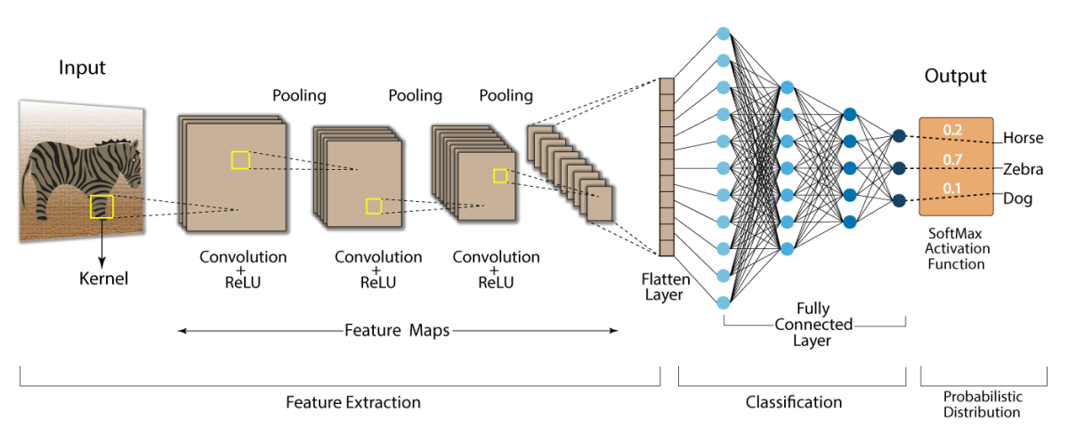
3. Convolutional Neural Networks
Convolutional neural networks, also called ConvNets or CNNs, have several layers in which data is sorted into categories. These networks have an input layer, an output layer, and a hidden multitude of convolutional layers in between. The layers create feature maps that record areas of an image that are broken down further until they generate valuable outputs. These layers can be pooled or entirely connected, and these networks are especially beneficial for image recognition applications.

Slide 9
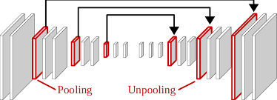
4. Deconvolutional Neural Networks
Deconvolutional neural networks simply work in reverse of convolutional neural networks. The application of the network is to detect items that might have been recognized as important under a convolutional neural network. These items would likely have been discarded during the convolutional neural network execution process. This type of neural network is also widely used for image analysis or processing.

Slide 10
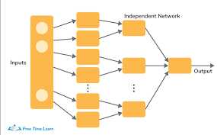
5. Modular Neural Networks
Modular neural networks contain several networks that work independently from one another. These networks do not interact with each other during an analysis process. Instead, these processes are done to allow complex, elaborate computing processes to be done more efficiently. Similar to other modular industries such as modular real estate, the goal of the network independence is to have each module responsible for a particular part of an overall bigger picture.

Slide 11
Pros and Cons of Neural Networks
Pros
Can often work more efficiently and for longer than humans
Can be programmed to learn from prior outcomes to strive to make smarter future calculations
Often leverage online services that reduce (but do not eliminate) systematic risk
Are continually being expanded in new fields with more difficult problems
Cons
Still rely on hardware that may require labor and expertise to maintain
May take long periods of time to develop the code and algorithms
May be difficult to assess errors or adaptions to the assumptions if the system is self-learning but lacks transparency
Usually report an estimated range or estimated amount that may not actualize

Slide 12
Application of Neural Networks
1. Facial Recognition
Convolutional Neural Networks (CNN) are used for facial recognition and image processing. Large number of pictures are fed into the database for training a neural network. The collected images are further processed for training.
2. Stock Market Prediction
To make a successful stock prediction in real time a Multilayer Perceptron MLP (class of feedforward artificial intelligence algorithm) is employed. MLP comprises multiple layers of nodes, each of these layers is fully connected to the succeeding nodes. Stock’s past performances, annual returns, and non profit ratios are considered for building the MLP model.
3. Weather Forecasting
Multilayer Perceptron (MLP), Convolutional Neural Network (CNN) and Recurrent Neural Networks (RNN) are used for weather forecasting. A combination of different types of neural network architecture can be used to predict air temperatures.

Slide 13

The Bottom Line
Neural networks are complex, integrated systems that can perform analytics much deeper and faster than human capability. There are different types of neural networks, often best suited for different purposes and target outputs. In finance, neural networks are used to analyze transaction history, understand asset movement, and predict financial market outcomes.

Slide 14
That's a wrap!
Thank
you!

